Slide 1
Garage Door Controller via Bluetooth
Eng. Wafaa Mohamed
Group: N5

Slide 2
Introduction
Due to the exceed of the technology phenomena in the world, it has token a well place in our life, and one of the simple modern communication technology is a far remote controlling any thing like, curtains, fans, may be cars, and of course doors.
So let’s present a simple program for garage door remote controlling.

Slide 3

Type of controlling
One of the simplest ways to remote controlling the garage door is by controlling it via Bluetooth from your own car, open and close it with even light indication.

Slide 4
User manual
1- Set-up a Bluetooth application on your smart phone to send data through it.
2-After pairing with the door Bluetooth module send digit 1 to open the door and digit 2 to close.

Slide 5
State machine diagram
Start device
Waiting for order
Receiving any other data
ERROR
Receiving 2
Close door
Checking order
Receiving 1
Open door

Slide 6
How its actually works
There are two AVRs used in this application. The first one is to receive the data from your Bluetooth controller and decide if the command which has been sent is right or not.
If it is a right command it sends a direct order to the other microcontroller to open or close the door, showing that on its LCD, but if the command is wrong the LCD will write a message asking the user to send the right one.

Slide 7
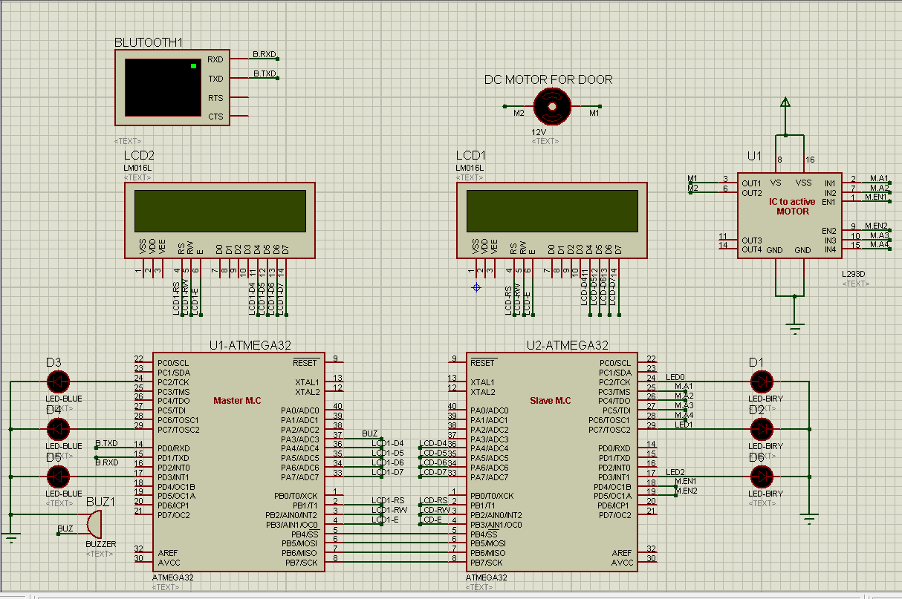
Circuit diagram

Slide 8
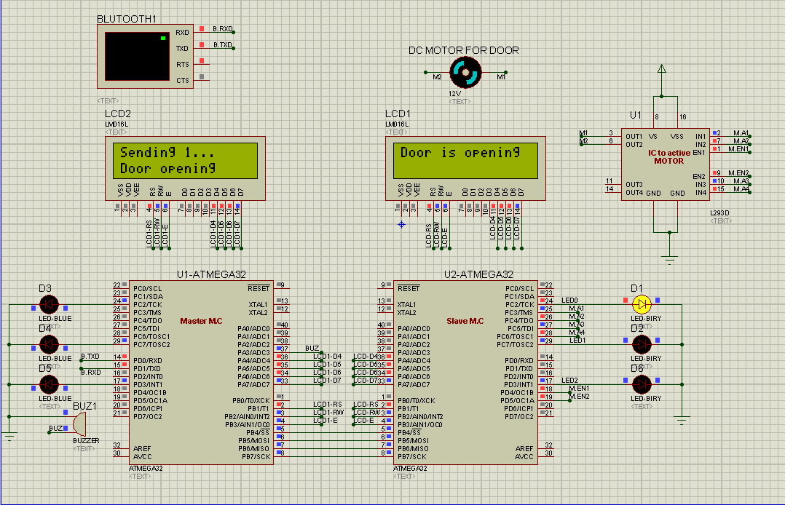
Case of typing 1

Slide 9
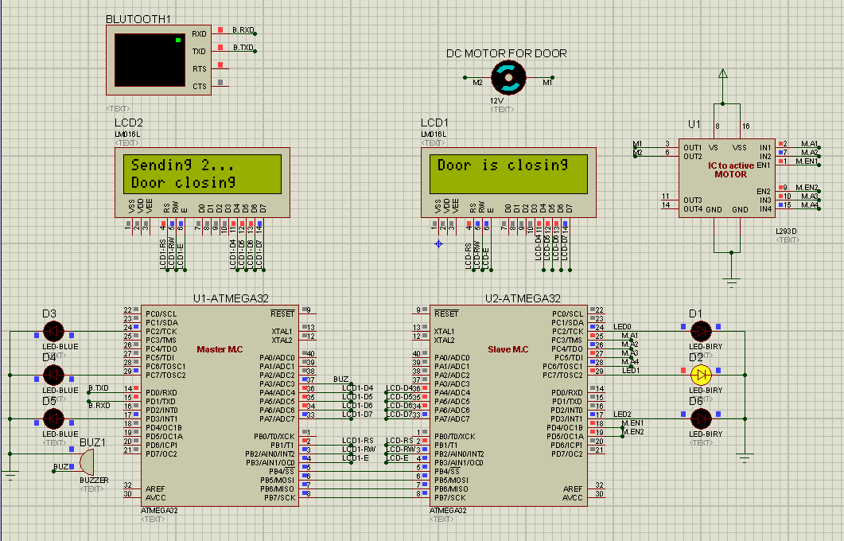
Case of typing 2

Slide 10
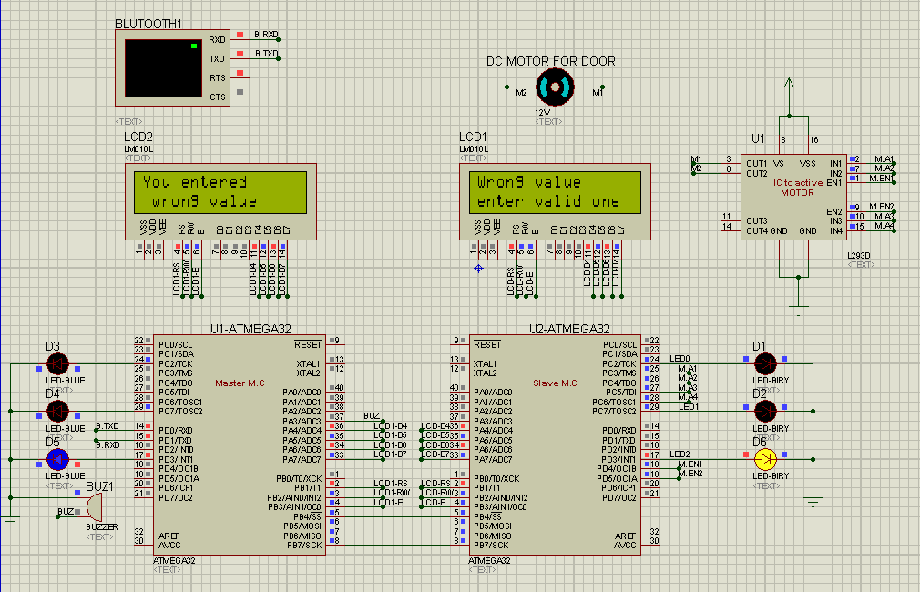
Case of typing wrong value

Slide 11
Used component
ATMEGA 32 microcontroller
Bluetooth module
16x2 LCD
LEDs as light indicators
Motor to move the door
H-bridge IC to control the motor move direction

Slide 12
Flow chart diagram
Start
2
1
Waiting for new condition
Check value
FALSE
TRUE
Turn the motor CCW to close the door
Turn the motor CW to open the door
Check condition
Waiting for new condition

Slide 13
Programming
The program has been written using Microchip-Studio compiler.
The project has been created using the layer architecture technique

Slide 14
Layer architectures
1- Microcontroller Abstraction Layer (MCAL)
MCAL is a software module that directly accesses on-chip MCU peripheral modules and external devices that are mapped to memory, and makes the upper software layer independent of the MCU.
2- Hardware abstraction layer (HAL)
HAL is a software module that allows a MCU OS to interact with a hardware device at a general or abstract level rather than at a detailed hardware level.
3- application layer(App layer)
The application layer is the topmost layer of the project architecture and supports custom functionalities implementation. This layer consists of the specific software components and many applications, which are a group of interconnected AVR Components and perform specific tasks as per instructions.

Slide 15
Layers creation tools
For text replacement, Macros (#define) has been used.
Including dictionaries was by (#include” “) for user defined libraries(pins ,ports configuration library), or by using (#include< >) for the predefined library like interrupt, delay,…libraries
And we can’t forget about the guard of files which used in header files in the following form:
#ifndef FILE_H_
#define FILE_H_
File body
#endif /* FILE_H_*/

